Slide 1
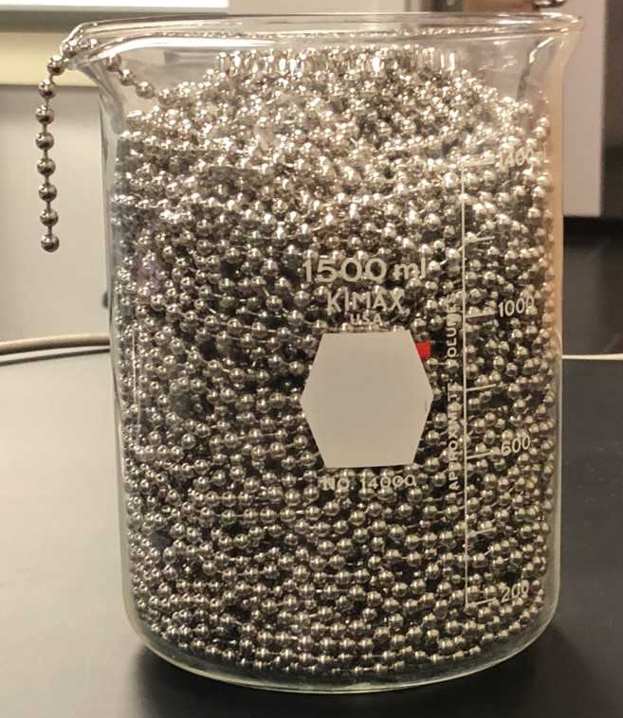
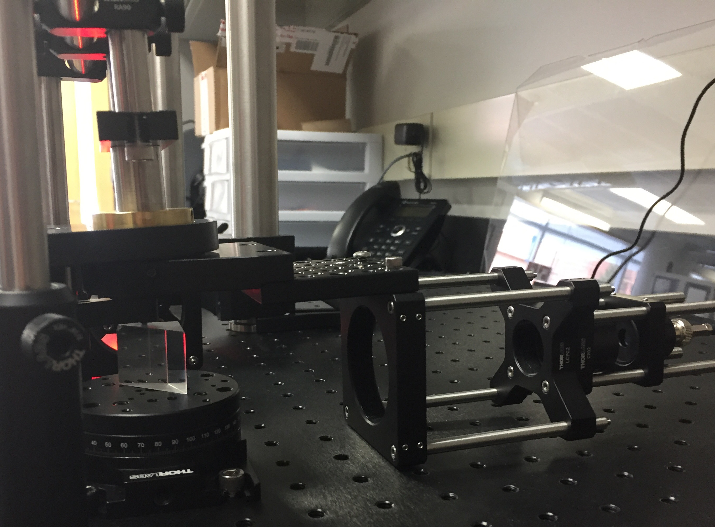
Introduction
The Experiments
Communication Skills
A new Advanced Physics Lab course was developed to give students traditional experimental skills. It was offered in conjunction with a freshman level Introduction to Research Methods in Physics course. This combination was done to populate a traditionally low-enrolled upper-division course, to provide senior students with leadership experience, and to provide freshmen an authentic research experience.
The freshman course has no physics prerequisite and counted as a general education science credit. It focused on skills such as keeping lab notebooks, working as a member of a team, scientific ethics, and scientific communication. The advanced lab course focused on skills in leadership, mentoring, working in teams, scientific ethics, experimental design, advanced data analysis, scientific communication, and experimental skills specific to a project.
Saturation Absorption Spectroscopy of Rubidium
Characterization of a Capacitive Plasma Discharge
Stabilization of a Helium Neon Laser
Surface Plasmon Resonance in Thin Films
Chain Fountain Modelling
The laboratory notebook is one of a researcher’s most powerful tools. Interviews with scientific researchers tell of no formal training in the use of laboratory notebooks[3]. What training students receive is ineffective[4]. In order to encourage student ownership of the projects[5], the first week of class was spent discussing the importance of lab notebooks and developing a rubric for notebooks as a class[6]. Electronic notebooks[7] were used to allow team members to see one another’s work and give feedback.
Each week a member from each team would give a five-minute presentation to the class on the state of their experiment. All students and the instructor provided feedback.
Summative communications included
A twenty-minute presentation,
Local poster presentation,
Summary paper.
“[This class] has made me more confident with scientific research. I was not sure how to structure an experiment before taking this class. “
Experimental Design
“I did not like physics before I took this class. I was never very good at it and I was thinking it was going to be really hard. But now I love this class and I feel like I know what I am doing and how my skills relate to our experiment. “
Students where introduced to the idea of asking “big questions” and “little questions”. A big question is answered over the course of the semester; it is their main goal to answer it. A little question is something that can be answered on a shorter timescale and typically involves a few experiments.
“This class is very helpful for teaching group dynamics, most projects in other classes are not nearly as long. For freshman, its very good and should almost be required, for seniors, it is also good but noticeably less so.”
Course Goals
Results and Future Directions
Introduction to Research Methods in Physics
A student who has completed this course will be able to:
Explain the purposes and goals of experiments.
Design an experiment to test a hypothesis.
Analyze data and report relevant information.
Communicate scientific information orally and in writing.
Work effectively in a team.
Advanced Physics Lab
A student who has completed this course will be able to:
Use typical experimental physics equipment.
Design an experiment to test a hypothesis.
Analyze data and report relevant information.
Communicate scientific information verbally and in writing.
Read research articles.
Lead a team of researchers.
At the start of each period, each team would discuss:
the little questions they were working on,
how little questions moved them towards answering the big question,
new little questions that had come up or still needed to be answered.
Out of thirteen respondents, eleven would recommend the class to a friend while the remaining two stated they did not recommend classes that aren’t required. Student feedback on the skills learned in the course include:
Four out of six students in the upper-level course mention developing leadership skills.
Four out of seven students from the introductory course mention learning better teamwork skills.
Two out of thirteen students mention improved communication skills.
Two out of thirteen mention improved critical thinking skills.
All quotes in this poster are from students in the course.
Based on student feedback, future courses will include:
More information on data analysis,
More guidance on how to write a good research paper,
Instruction on how to 3D print parts for the experiments,
Case studies for the section on ethics, developed from existing readings.
Since one of the objectives is for each group of students to improve upon experiments, future groups will start with the paper written during the first offering of the courses and build upon it.
“This lab teaches tenacious thinking and the ability to completely rework a setup that doesn't work”
Teamwork
Two lecture class periods were spent on teamwork (for the intro class) or leadership (for the advanced class). At the end of each week the group would come together to answer the questions “what is an example of something you did this week that shows good teamwork” and “what can you do next week to improve your ability to work as a team”[1].
The advanced students would spend the first few minutes of the weekly lecture section discussing successes or issues that came up in their group and discussed how to improve their group performance.
“[This class] made me realize how much of a collaborative effort real research can be, as well as how time-consuming it can be.”
Course Structure
Both courses had two, three-hour lab sessions, and a separate one-hour lecture session.
There were six students in the advanced and eight in the intro course. Most were physical science majors, two were math majors and one an interior design major.
Graded assignments included lab notebook checks, short oral reports, a poster, a paper, and a final group oral report.
The first week of class was devoted to use of lab notebooks, data plotting, and being an effective team member. Students indicated preferences for an experiment.
In the second week, students were assigned to a project and research group, consisting of an advanced student and one or two intro students.
References
“[This class] made me realize that working in a team can be beneficial if the team leader has an idea of the direction they want to go and if the teammates are motivated. “
[1]Lingard, Robert W. "Teaching and assessing teamwork skills in engineering and computer science." Journal of Systemics, Cybernetics and Informatics 18.1 (2010): 34-37.
[2]Hollander, Rachelle, and Carol R. Arenberg, eds. Ethics Education and Scientific and Engineering Research: What's Been Learned? What Should Be Done? Summary of a Workshop. National Academies Press, 2009.
[3] Stanley, J. T., & Lewandowski, H. J. (2016). Lab notebooks as scientific communication: Investigating development from undergraduate courses to graduate research. /Phys. Rev. Phys. Educ. Res./, /12/(2), 020129–11. http://doi.org/10.1103/PhysRevPhysEducRes.12.020129
[4]Stanley, J. T., & Lewandowski, H. J. (2018). Recommendations for the use of notebooks in upper-division physics lab courses. /American Journal of Physics/, /86/(1), 45–53. http://doi.org/10.1119/1.5001933
[5] Stanley, J. T., Dounas-Frazer, D. R., Kiepura, L., & Lewandowski, H. J. (2016). Investigating student ownership of projects in an upper-division physics lab course (pp. 336–339). Presented at the 2016 Physics Education Research Conference, American Association of Physics Teachers. http://doi.org/10.1119/perc.2016.pr.079
[6] Atkins, L. J., Proceedings, I. S. A. C., 2013. (n.d.). Using scientists’ notebooks to foster authentic scientific practices. /Aip.Scitation.org/
[7] Eblen-Zayas, M. (2015). Comparing Electronic and Traditional Lab Notebooks in the Advanced Lab (pp. 28–31). Presented at the 2015 Conference on Laboratory Instruction Beyond the First Year, American Association of Physics Teachers. http://doi.org/10.1119/bfy.2015.pr.007
Ethics
In addition to one lecture period devoted to ethical behavior in science research[2], it was also included explicitly when discussing keeping lab notebooks, when working as part of a team, and when reporting results.
Special thanks to Marlann Patterson for her time, expertise, and the use of her equipment for the plasma discharge project.

